Slide 1

Modern C++
How not to lose your memory

Slide 2

The Unix Beard

Slide 3
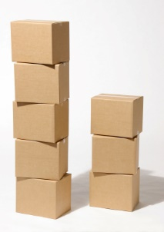
The Stack

Slide 4

Garbage Collection

Slide 5
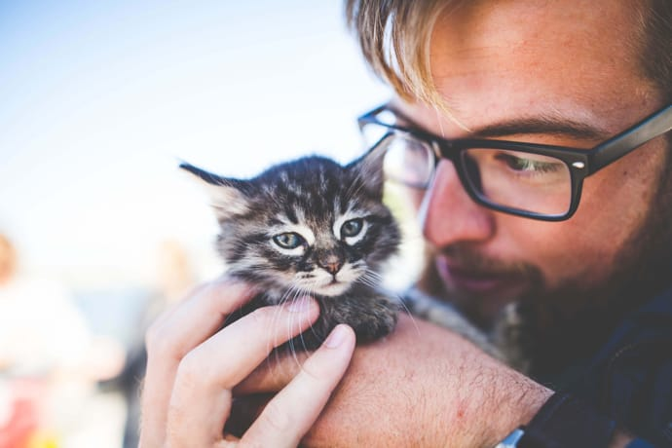
Pointer ownership

Slide 6
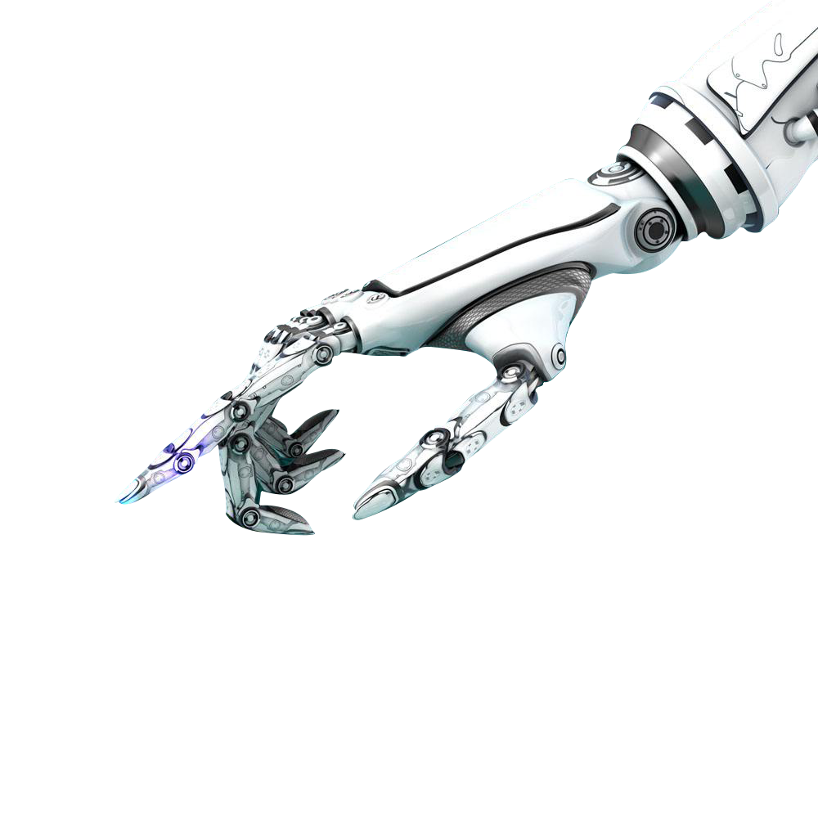
auto_ptr<T>

